Slide 1





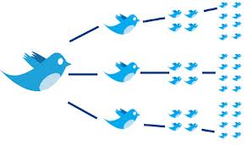


USER GENERATED CONTENT ANALYTICS MIS373 Fall 2017 Sessions 1 & 2, 08/31, 08/05
Dr. Anitesh Barua
David Bruton Jr. Centennial Chair Professor of Business
Distinguished Fellow, INFORMS Information Systems Society
Stevens Piper Foundation Professor
University of Texas Distinguished Teaching Professor
Associate Director, Center for Research in e-Commerce
McCombs School of Business, University of Texas at Austin
Email: aniteshb@gmail.com

Slide 2
Before and After this Course
Do you know how to | Yes/No
Assess the impact of online platforms in customer purchase decisions?
Analyze what type of content increases engagement?
Assess the predictive power of unstructured data on diverse outcomes such as healthcare to energy
Combine structured & unstructured data in analytic models?
Copyright Anitesh Barua 2017

Slide 3
Before and After this Course
Do you know how to | Yes/No
Extract tweets with detailed user info including location & other attributes?
Extract conversations in online forums, blogs, youtube, etc.?
Analyze unstructured data to generate new insights and discover facts?
Leverage the wisdom of the crowd?
Analyze consumer sentiments using supervised and unsupervised methods?
Predict business outcomes (e.g., sales) from social data
Assess resonance between a message (e.g., a campaign) and response on social media?
Find influencers in social media?
Copyright Anitesh Barua 2017

Slide 4
User Generated Content
Once there were only numbers (e.g., demographic, sales, etc.)
But big data would not be big with just numbers
How did User Generated Content (UGC) contribute to the 3 Vs of big data?
~ 80% of UGC today generated by social media
And the rest 20% are?
Copyright Anitesh Barua 2017

Slide 5
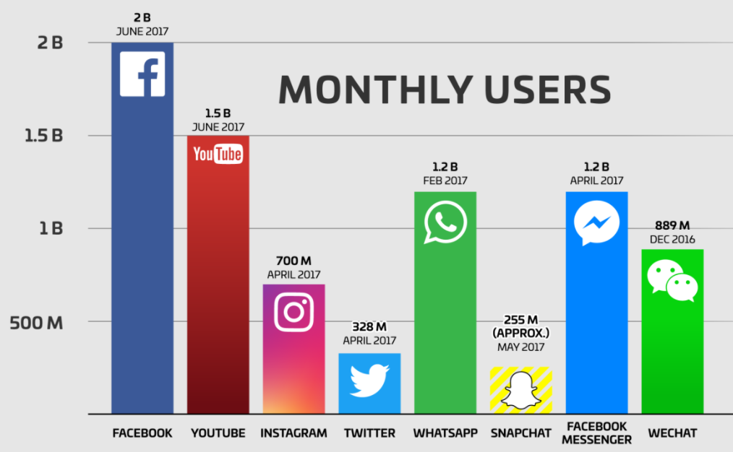
Why Bother About UGC?
Web pages, online conversations/posts, digital libraries, etc.
Twitter: 500 million daily tweets
FB: 4.75 billion pieces of content shared daily
Conversations in online forums

Slide 6
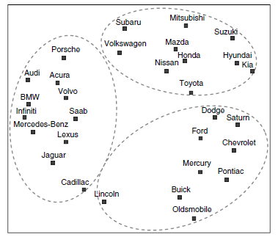
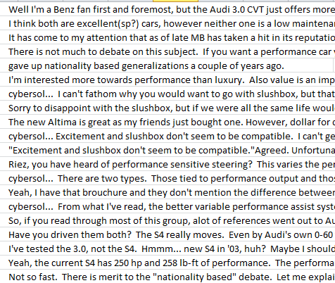
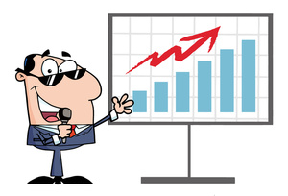
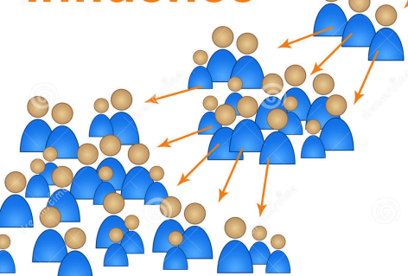
The Untapped Potential of User Generated Content
Insights:
Analyze brand
& product
associations
Prediction: E.g.,
salesrank,
retention,
spend, etc.
Metrics, metrics & more metrics
Who matter most:
Find influencers
Copyright Anitesh Barua 2017

Slide 7
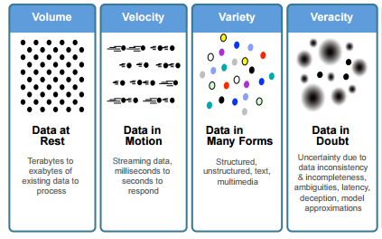
The Vs of Big Data (Revisited)
What has social got to do with the Vs of big data?
Source: IBM

Slide 8
Examples of What UGC Can Do
Novel sources of data
Publicly available home search data predicted changes in home prices better than forecasts of National Association of Realtors
Data from GoogleTrends & Twitter could predict flu-related ER visits long before CDC issued advisory.
Predict sales of new products much better than traditional forecasting models
What are the general business implications?
Source: McAfee & Brynjolfsson

Slide 9
Business Applications With Unstructured Data
Healthcare
Which CHF patients will be readmitted?
Free-form inputs (text) about lifestyle most important predictor
Electric grid failures
Traditional models
Enriching with text
Predicting business outcomes from online conversations & wisdom of the crowd
Copyright Anitesh Barua, 2017

Slide 10
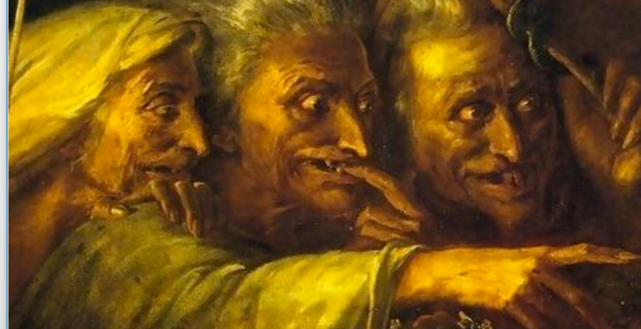
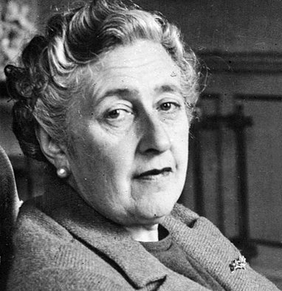
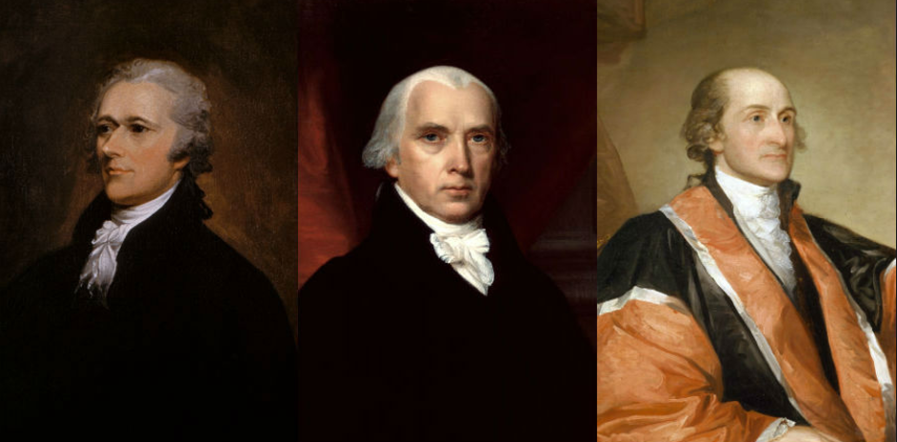
Innovative Applications Outside of Business Domain
Literature
Who wrote Macbeth?
When did Agatha Christie develop Alzheimer’s?
History
Who wrote the Federalist papers?
https://www.lexalytics.com/lexablog/2015/who-wrote-macbeth-3-things-text-mining-can-tell-us-about-authors

Slide 11
Pros & Cons of Online Social Data
Pros (relative to a survey) | Cons | Mitigation

Slide 12
A 50k Feet Overview of User Generated Content Analytics

Slide 13
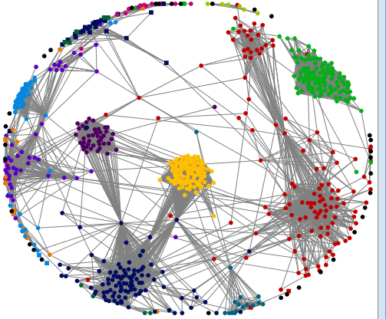
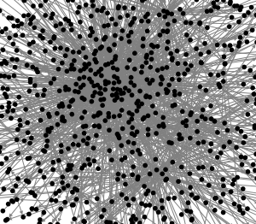

1. “Democratization of the Lady Gaga Effect”
From channels to platforms
Conversations are now visible
Key themes, sentiments, attention,
influence, etc. can be measured
Copyright Anitesh Barua 2017

Slide 14
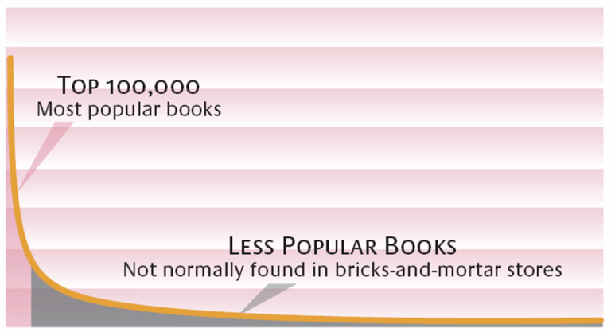
2. The Long Tail* & Social Media
Effect of the Internet
Sales
High Popularity Low
Customer preferences are diverse & revealed in social chatter
New opportunities for push strategies, word-of-mouth & social influence
Not feasible if you have one-size-fits-all business strategy
Copyright Anitesh Barua, 2017
*Image Source: Brynjolfsson, Hu and Smith; *Chris Anderson

Slide 15
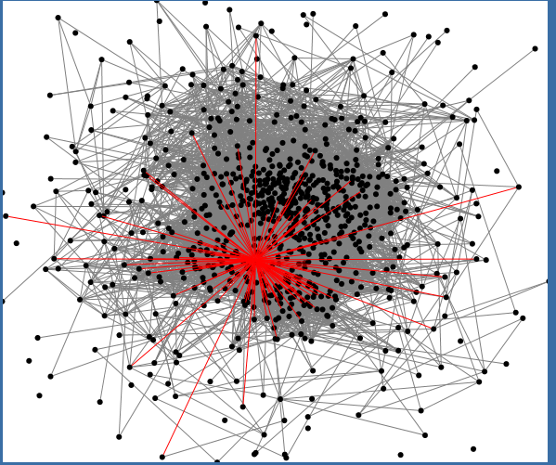
3. Your Network Location Matters Too
Who are most popular?
Who are “best” connected?
Who can help spread a message?
Who can help connect diverse groups?
Who’s that guy?
Copyright Anitesh Barua 2017

Slide 16
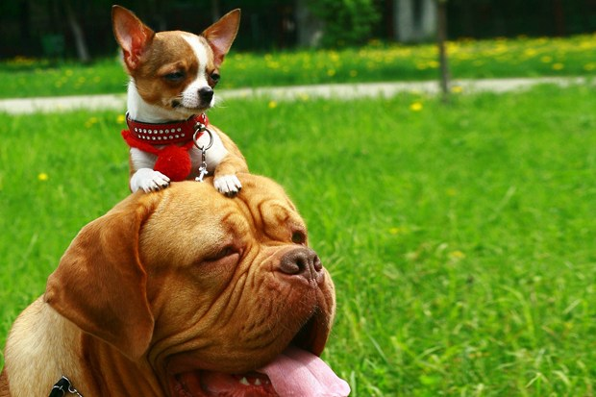
4. The Network Value of a Customer
From Customer Lifetime Value (CLV) to Customer Influence Value (CIV)
Customer Network Lifetime Value (CNLV) = CLV + CIV
Copyright Anitesh Barua 2017
Image Source: http://www.wired.co.uk/news/archive/2012-08/13/customer-network-lifetime-value

Slide 17


Where is the Social ROI?
Can social or digital Word-of-Mouth (WOM) ROI be higher than that of Web 1.0
(e.g., paid search)?
What kind of incentives are required for spreading the word in social networks?
How can we measure social ROI?
Copyright Anitesh Barua 2017

Slide 18
The Elusive Social ROI
“Google Analytics can’t tell you that I saw a friend snap a photo of their Wondermade marshmallows on Instagram six months ago, which triggered me to follow them on Twitter and Instagram, and finally triggered my first purchase a few months later by typing in their URL, and not by visiting a link they posted in social media …. In fact, by looking at their analytics, I’m a speck in their direct traffic.” (Amanda MacArthur, BuzzFarmers)
Tracking influence is a challenge in social space

Slide 19
5. Monitoring & Visualization Through Social Media
Unprecedented real time visibility into
Public reactions
Emerging phenomena or events
Customer preferences
Copyright Anitesh Barua 2017

Slide 20
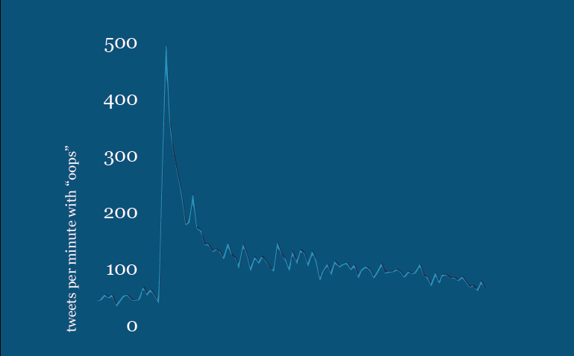
Real-time Assessment of Sentiment & Opinion: The “Oops” Tweets
Source: April Underwood, Twitter

Slide 21
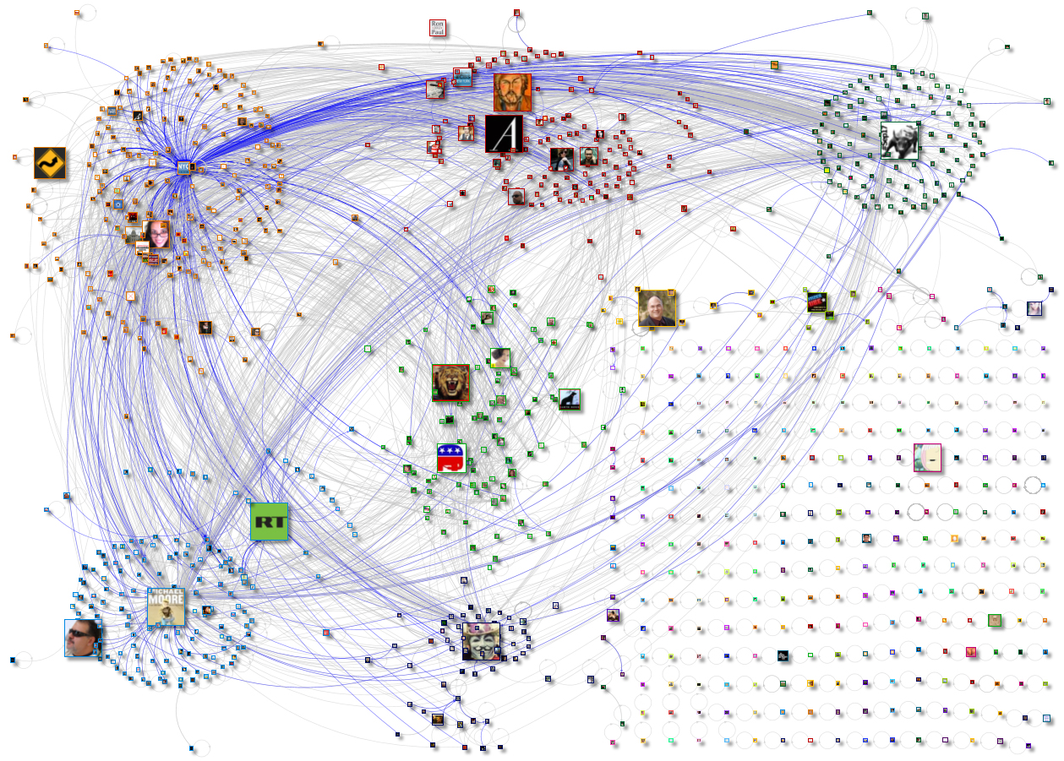
Tweets, Re-tweets: What do They Say?
Source: www.newscientist.com

Slide 22
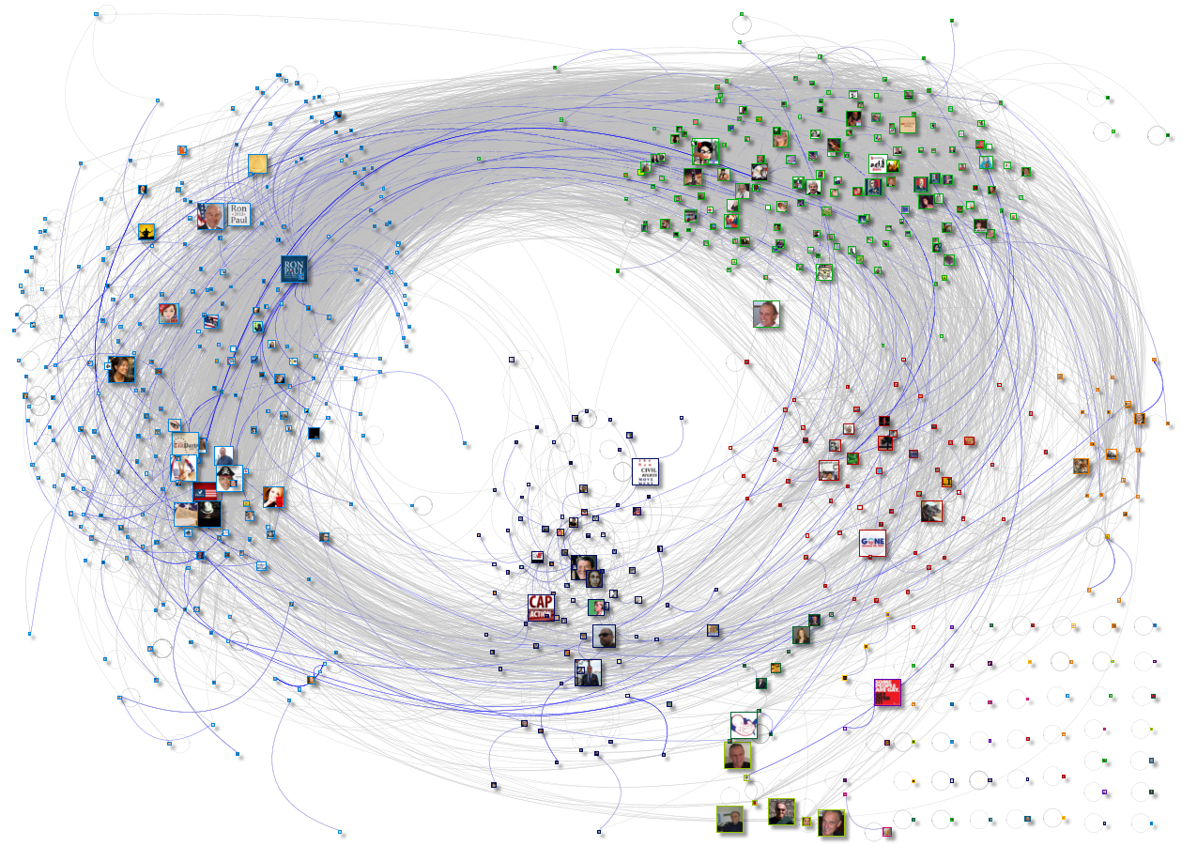
How is This Different From the Previous Network?
Source: www.newscientist.com

Slide 23
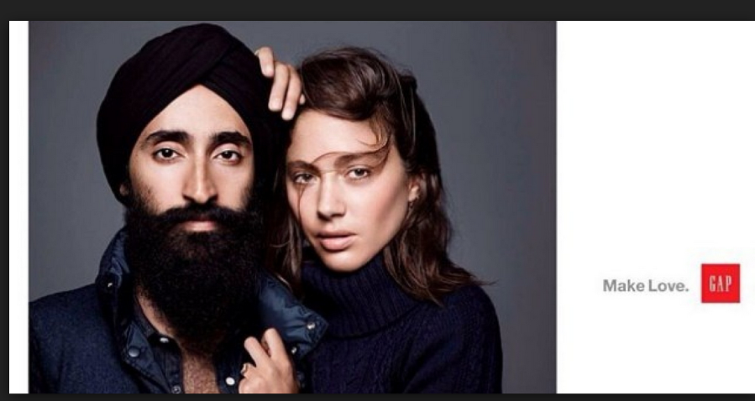
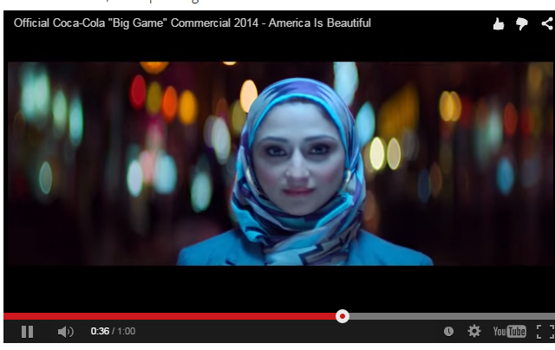
6. Knowledge Discovery from Social Media
User generated content (UGC) can reveal new insights about brands, products & events
E.g., do people associate Uber with lack of safety?
To what extent did consumers associate Gap (or Coke) with diversity after their unique ads?
Copyright Anitesh Barua 2017

Slide 24
7. Can We Predict Business Outcomes from Social Mentions?
E.g., use sentiment, key themes, volume, etc. to predict
Brand switching
Customer ratings & recommendation
Box office revenues
Stock price movements
Inventory requirements
Need suitable metrics
Copyright Anitesh Barua 2017

Slide 25
Tools We Will Use to Collect & Analyze Social Mentions
Collection tools: Python script (for Twitter), WebScraper for most sites (e.g., Yelp.com, TripAdvisor.com, etc.), Youtube scraper, etc.
Fetch social mentions
Social network analysis tools: E.g., NodeXL, Gephi, etc.
Visualization: XLStat
Sentiment analysis tools: SentiStrength, custom scripts
Text analytic tools: LightSIDE, custom Python scripts
Copyright Anitesh Barua 2017

Slide 26
Takeaways
Platform based conversations create new opportunities for business
Observe, engage & discover
Not just ‘a’ customer but customers embedded their social networks
Individual CLV to CIV and CNLV
Uniqueness of social data and new methods to visualize, explore and analyze
Copyright Anitesh Barua 2017

